Slide 1
Internship
Key Takeaways & Learning Improvements

Slide 2
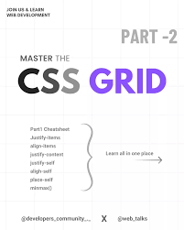
Key Takeaways
CSS Layout Mastery: Understood styling concepts like box model, selectors, positioning, Flexbox, and Grid.

Slide 3
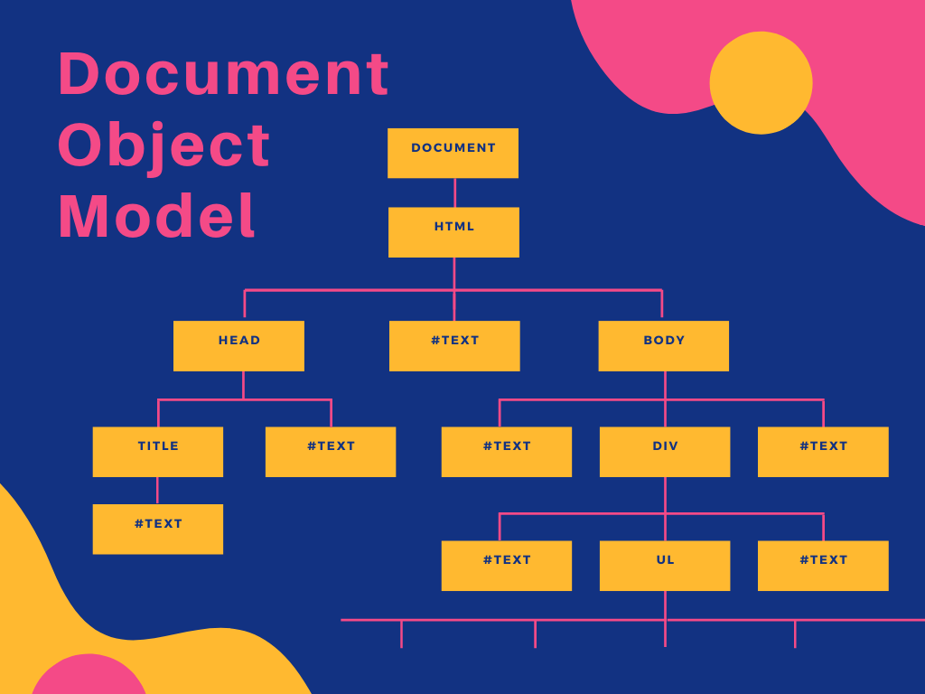
Key Takeaways
JavaScript DOM Manipulation: Hands-on experience selecting elements, modifying attributes, and handling events.

Slide 4
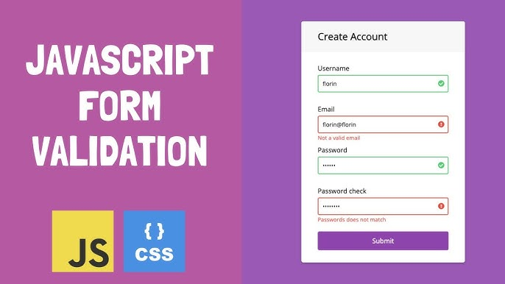
Key Takeaways
Form Validation & Interactivity: Built a dynamic 'Contact Us' form with input validation and interactivity.

Slide 5

Key Takeaways
Angular Fundamentals: Learned Angular basics including components, state, routing, and state management.

Slide 6
How I Can Improve My Learning
Practice real-world mini projects to strengthen problem-solving.
Contribute to open-source or group projects for hands-on experience.
Revise and explore advanced use cases of ES6+ and Angular.
Follow documentation and tutorials to stay updated with best practices.

Slide 7


Slide 8

Thankyou

